Slide 1
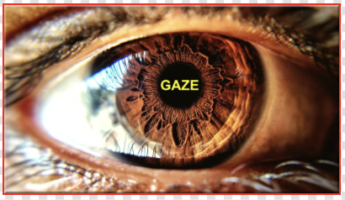
Eye Movement Pattern Based Authentication System
Presented by Group - 6 [ Project Exhibition II ]

Slide 2
Contents
Overview
Understanding the Problem
Project Objectives
Proposal Abstract
General Architecture
Target audience
Timeline
Conclusion

Slide 3
Overview
As privacy is an issue that cannot be overlooked, particularly when it comes to the digital information, it is vital to enhance and improve existing authentication methods, or to build a new one, as some have been demonstrated to be vulnerable.
In light of this necessity, it was decided to adopt a new approach based on eye movements, in which an eye tracking authentication system will be used to provide an extra layer of security to the existing pin or password based authentication model.
Notes:
Tushar

Slide 4
Understanding the Problem
Pupil and Iris of Human Eyes are considered to be really strong biometrics that can be used for unique authentication of an individual.
In normal Biometric Authentication systems, there is a high probability of false matches which can be made resistant to in cases of Eye Movement Pattern Based Authentication system.
While validating a usual method of authentication, there is a form of validation needed which includes searching an entire database of known passwords which can be time consuming and less-effective.
Normal authentication techniques can be altered by threat actors to gain unauthorized access to a secured system
Notes:
Chirag

Slide 5
Project Objective
Iris Movement and gaze tracking has been an active research field in the past years as it adds convenience to a variety of applications. The goal of this project is to present a model on the existing literature on Iris Movement and Gaze Tracking and Develop an Efficient Technique that can revolutionize the field of Computer Vision. A Motion analysis method is developed to track and detect Iris movement and gaze Tracking. They serve the purpose of being used as an authentication method in many login based applications which require continuous authentication. The main purpose of the system is the motion analysis method and finding Horizontal Ratio to Find the Direction of Vision i.e., Left, Right or Centre.
Notes:
Blesson

Slide 6
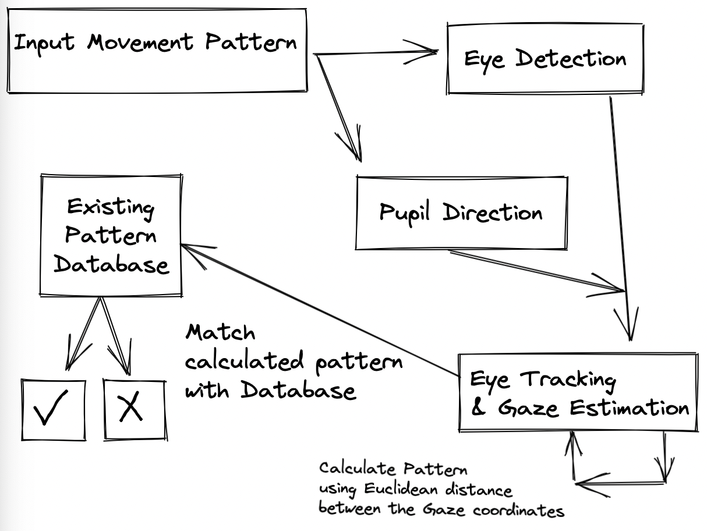
Proposal Abstract
The project application will contain 2 parts:
Database: to store the gaze pattern coordinates that will be matched at the time of authentication
Backend Machine Learning Model: trained to detect the gaze movement & generate the pattern coordinates and calculate the Euclidean distance between them
The distance at every point will give us the direction of the gaze and thus match them with the existing pattern in the Database, if they match then the Authentication is successful & access is granted otherwise the access is denied
Notes:
Chirag

Slide 7
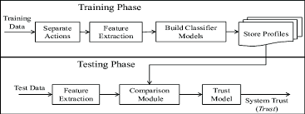
Proposal Abstract
Continuous Authentication changes the perspective of authentication from an event to a process & thus assists in securing the authentication mechanism from threats.
The Eye Movement Pattern Based Authentication system is going to implement the process of Continuous Authentication by detecting the eye movements in real time at a constant time interval (Behavioral characteristics, Uniqueness & Universality) to avoid unauthorized access.
Machine Learning Model Approach for Continuous Authentication
Notes:
Chirag

Slide 8
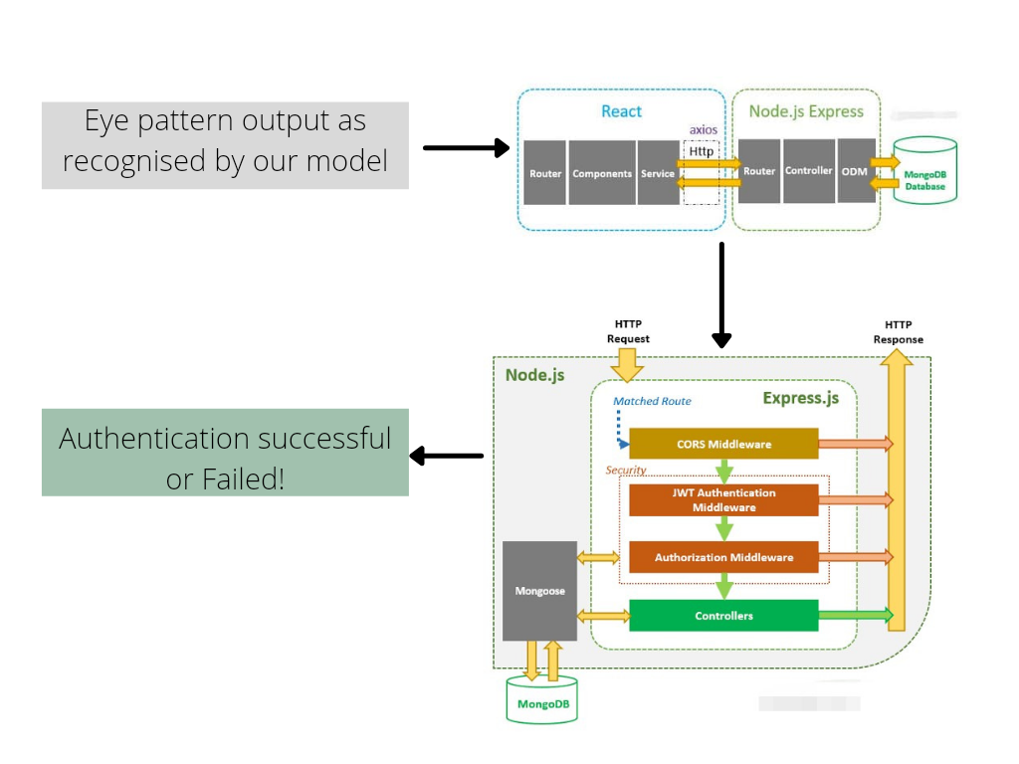
General Architecture
Notes:
Subham

Slide 9
Target Audience
They serve a wide range of severely disabled people who are left with minimal motor abilities. In this work, we want to put some light on the new system in which Using the eye as an interface to communicate with a system for people that are severely paralyzed or affected by diseases in which they are unable to move or control most of their body parts except for their eyes.
The target audience for this project could be major B2B and B2C applications wherein an authentication is required is required for essential services like e-payment and other sensitive e-commerce applications.
This mode of security provides an advanced concept in the cyber security field known as continuous authentication. Continuously using the Iris movement pattern with the password for a login based system provides an extra security layer and further reduces the need for a physical OTP in the process of two factor authentication which is much needed in this ‘hacker-booming’ cyberspace that exists today.
Notes:
Blesson

Slide 10
Project Timeline (Estimated)
OCT
NOV
DEC
Week-1
Week-2
Week-3
Week-4
Week-5
Week-6
Ideation stage, Research discussion and Review-1
Coding, Implementation, Iteration
Further Implementation and
API Building and Backend Development, Review 2
Building the last remaining parts and other work as needed
Completion, Almost Ready to be deployed and Final review
Notes:
Subham

Slide 11
Conclusion
When it comes to digital devices, information security is a critical consideration. We are constantly concerned that our personal information will not be misused.
That is why using Iris Movement and Gaze tracking approach to verify that a person is who he claims to be has been used here as it is also considered effective and reliable human-computer interaction.
This extra layer of security will make sure that an unauthorized person will not be able to access the data even if he has access to the pin or password.
This authentication will also be beneficial for a wide range of severely disabled people who are left with minimal ability to perform voluntary motion.
Notes:
Tushar

Slide 12

Presented By:
Tushar Gupta 19BCY10019
Blesson Biju Abraham 19BCY10079
Subham Biswal 19BCY10136
Chirag Ganguli 19BCY10158

